Slide 1

TED Talks Data Mining
—— Construction Step

Slide 2
Subtitles
ML - Regression
ML – Clustering & Classification
Backend
Frontend - Interfaces

Slide 3
1
ML - Regression

Slide 4
1. ML - Regression
As we can see from the heat map, the comments attribute has the most relevance to views, followed by languages.
At the end, we use four columns of our dataset, namely ‘duration’, ‘published_date’, ‘languages’ and ‘views’, to predict ‘comments’ by using Regression.

Slide 5
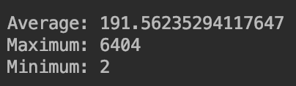
1. ML - Regression
Firstly we get the average number, maximum number and minimum number of ‘comments’ attribute. And we draw the histogram to see in which interval the data is concentrated.

Slide 6
1. ML - Regression
We tried the linear regression algorithm, ridge regression algorithm and the random forest algorithm. For the same data set, we calculated the MSE and RMSE of the three algorithms respectively. The results show that the results of the random forest algorithm are better than the others.
Linear regression model
Ridge regression model
Random forest regression model

Slide 7
1. ML - Regression
We used the yellowbrick library to visually analyze other error metrics. We plot the prediction error using the Lasso algorithm regression, which shows the difference between the actual and predicted models. From the figure we can see that the prediction model is close to the 45 degree line and matches the model.

Slide 8
1. ML - Regression
Also using the yellowbrick library, we use the Ridge Model to calculate the residual and get the residual scatter plot. In the figure we can see that the data is distributed near the horizontal axis, and in the histogram, our error concentration is concentrated around 0, indicating that our model fits well.

Slide 9
2
ML – Clustering & Classification

Slide 10
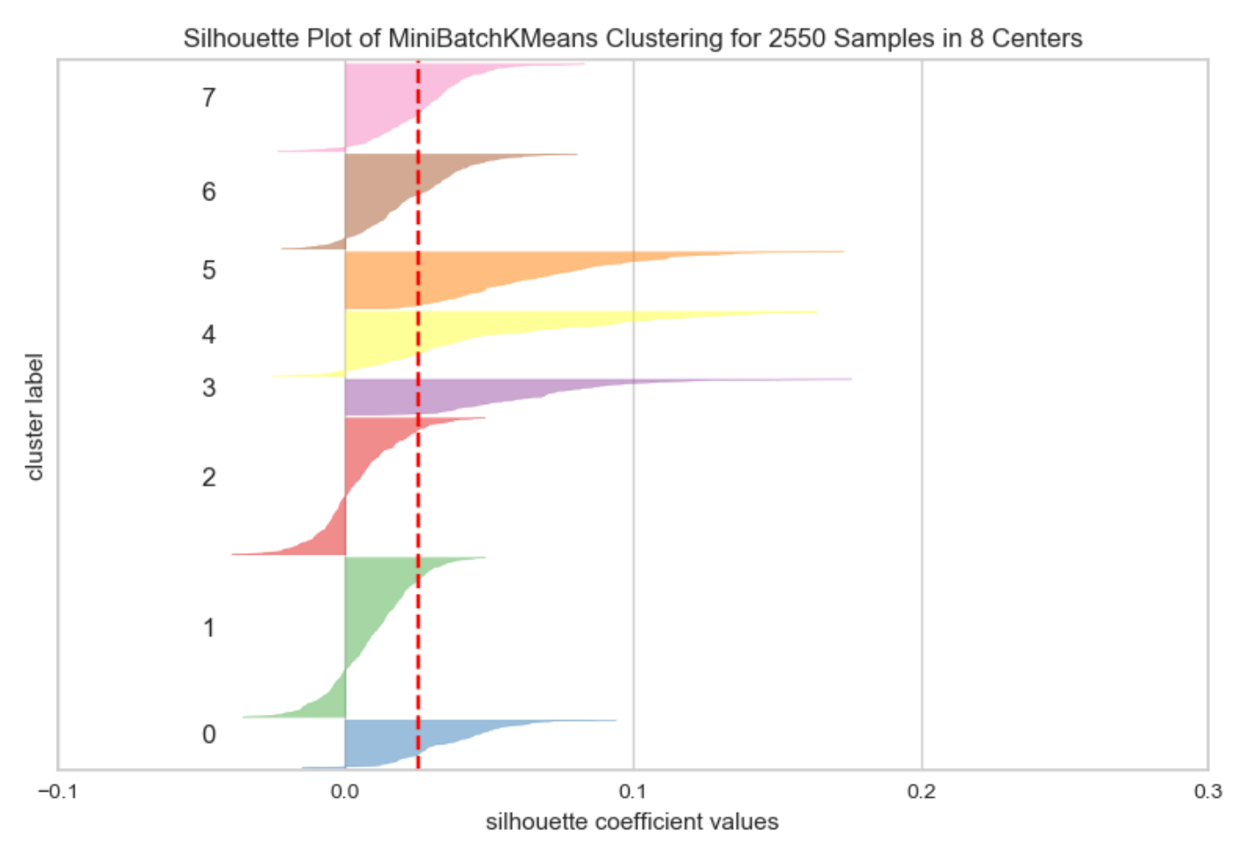
2. ML - Clustering & Classification
Clustering
We get a TF-IDF matrix based on the TF-IDF value of each 'tag' tag. By using TF-IDF as the eigenvalue, we trained to obtain a clustering model.
We calculated the Sihouette values for the eight clusters, and as shown, each category basically exceeded the average of the Sihouette value.

Slide 11
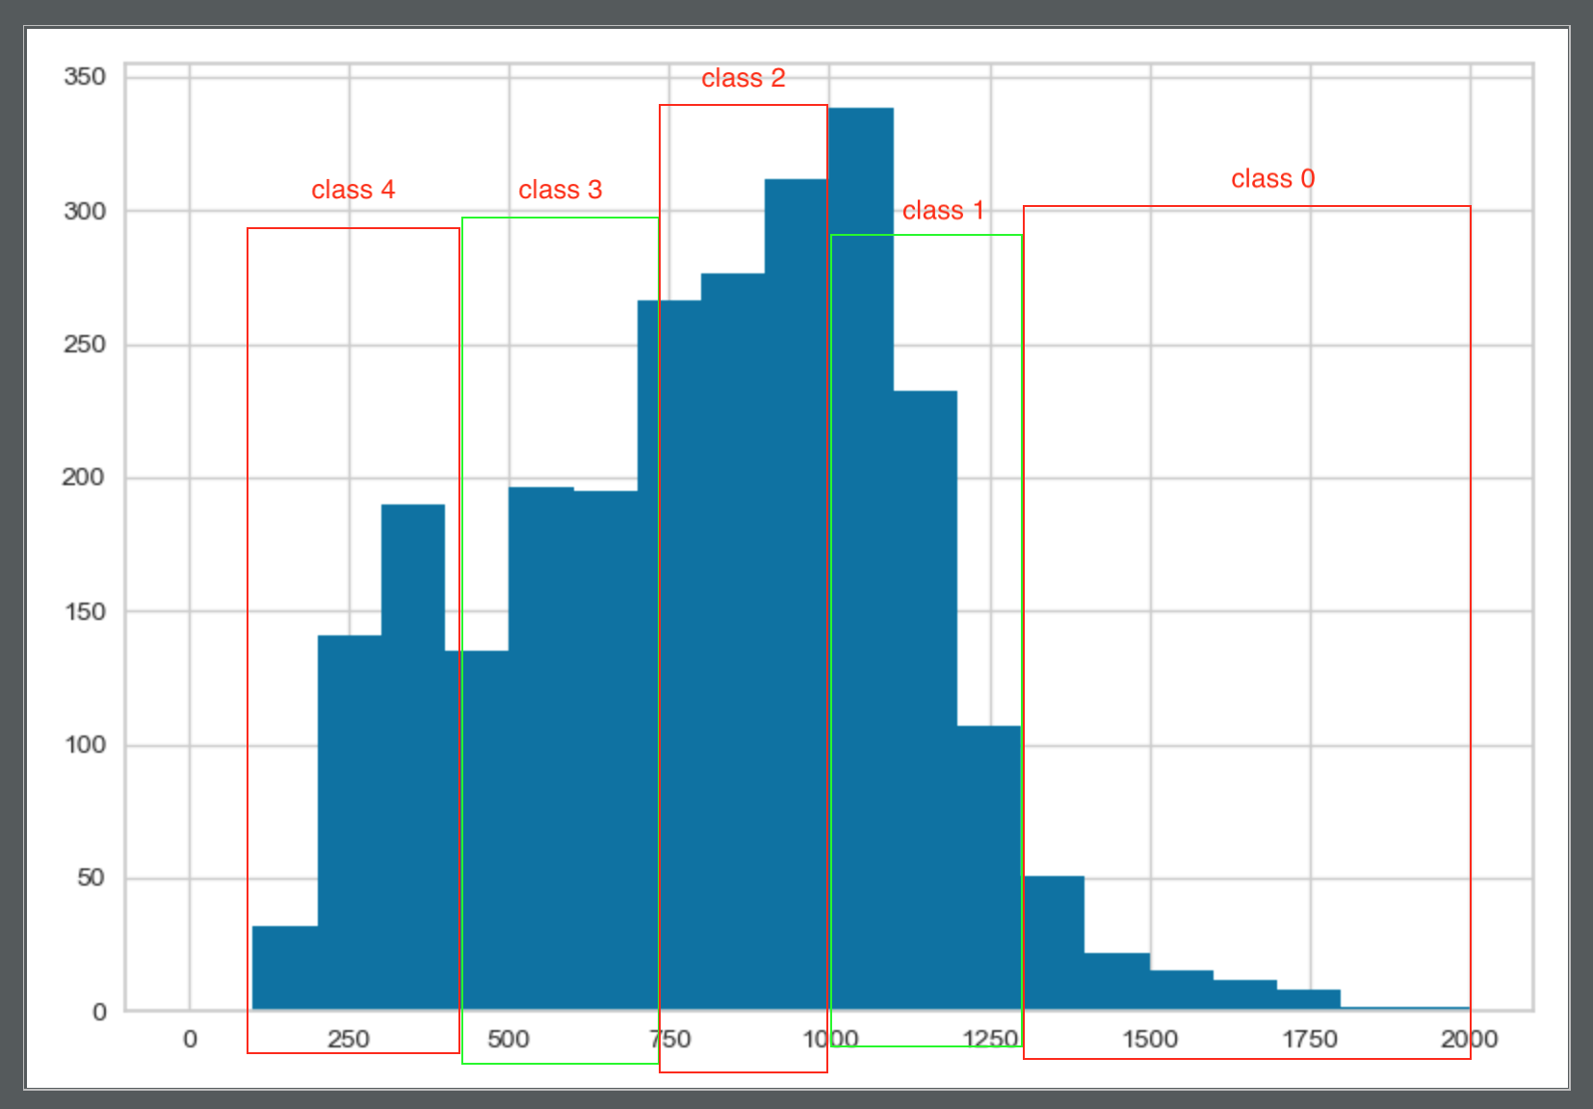
2. ML - Clustering & Classification
Classification - Label the Data
In order to create discrete eigenvalues for classification, we performed data tagging. We‘ve added four new columns of data, category data from clustering results, namely views, comments, and duration, which are graded by value. They are all discrete data in the form of natural numbers.

Slide 12
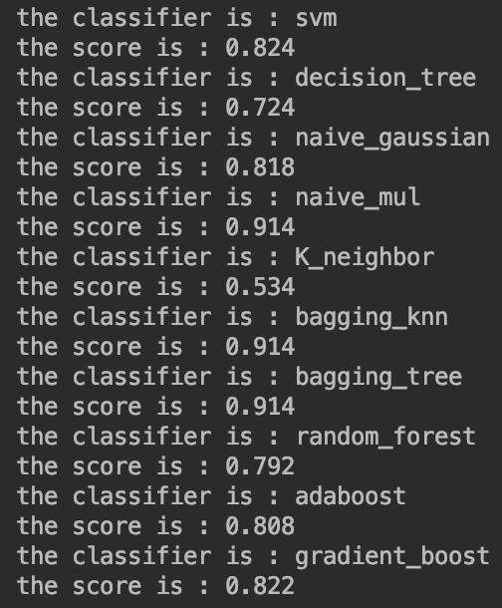
2. ML - Clustering & Classification
Classification – Using different algorithm
After getting the data, we try to classify using sklearn’s different classification algorithms and use the algorithm’s self-contained score() function to score the predictions of the test data.
The results show that the results obtained by the simple k-neighbor algorithm are the worst, and both the Bagging_knn and Bagging_DescisionTree as ensemble algorithms have good classification results.

Slide 13
ML: Timeline & Difficulties
Timeline
Difficulty: The results obtained by some algorithms are not good. We need to consider using some feature extraction techniques to make the results more realistic.
We have done the basic ML program, but it still need optimization.

Slide 14
3
Backend

Slide 15
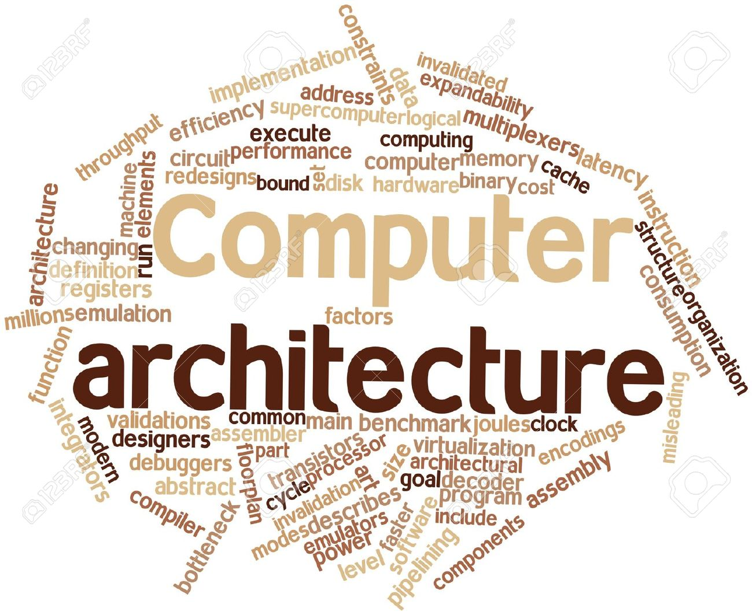

Slide 16
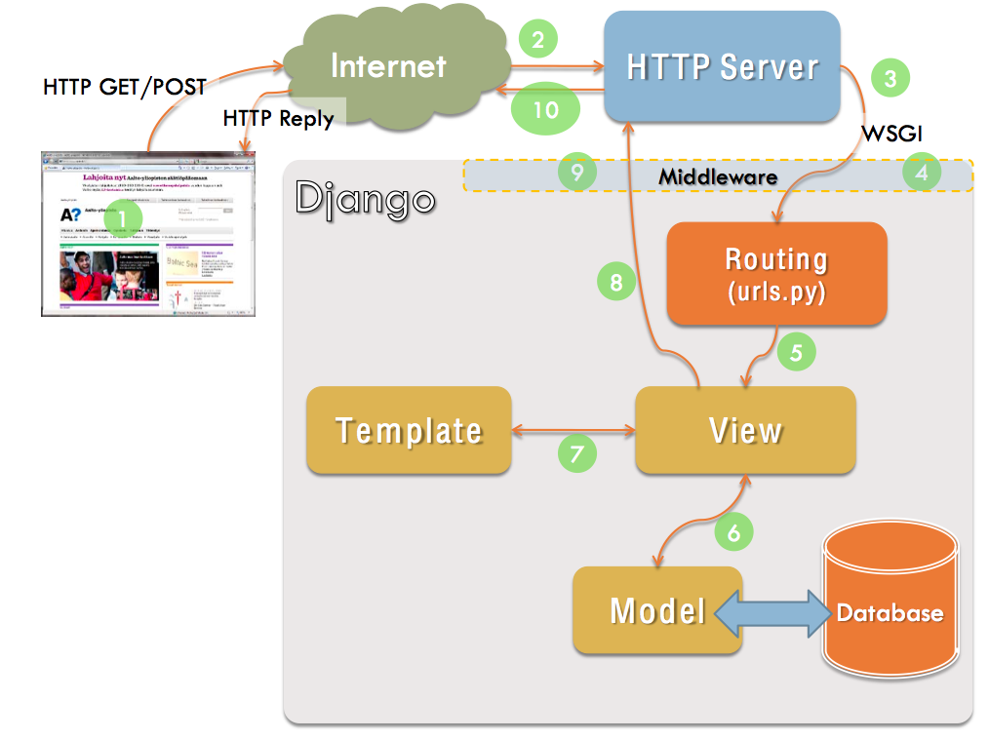

Slide 17
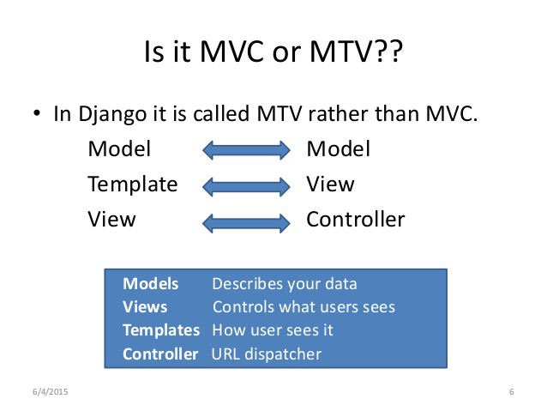

Slide 18

1.Recommadation ->url
2.Visualization ->plots, description
3.ML prediction ->result

Slide 19
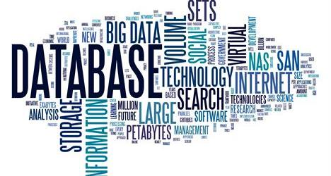
User
Id:int(main key)
Name:string
Password:string
Perferance:string
Nickname:string
isSuper:boolean
Movie
Id:int(main key)
Title:string
Tags:string
url:string

Slide 20


1. Data & ML & Visualization → Gui
2. Handling the http request form the front-end is difficult. For example, every time a user choose to like or dislike a talk, the back-ground should tackle the request and do many things:
record the current talk’s tags and store them into the current user’s preference and use the preference to predict the next talk and send the url of the talk to front-end

Slide 21


3days
Finish the background logical part
1days
Put data&ML in the application
2days
Integrate the application

Slide 22
4
Frontend - Interfaces

Slide 23
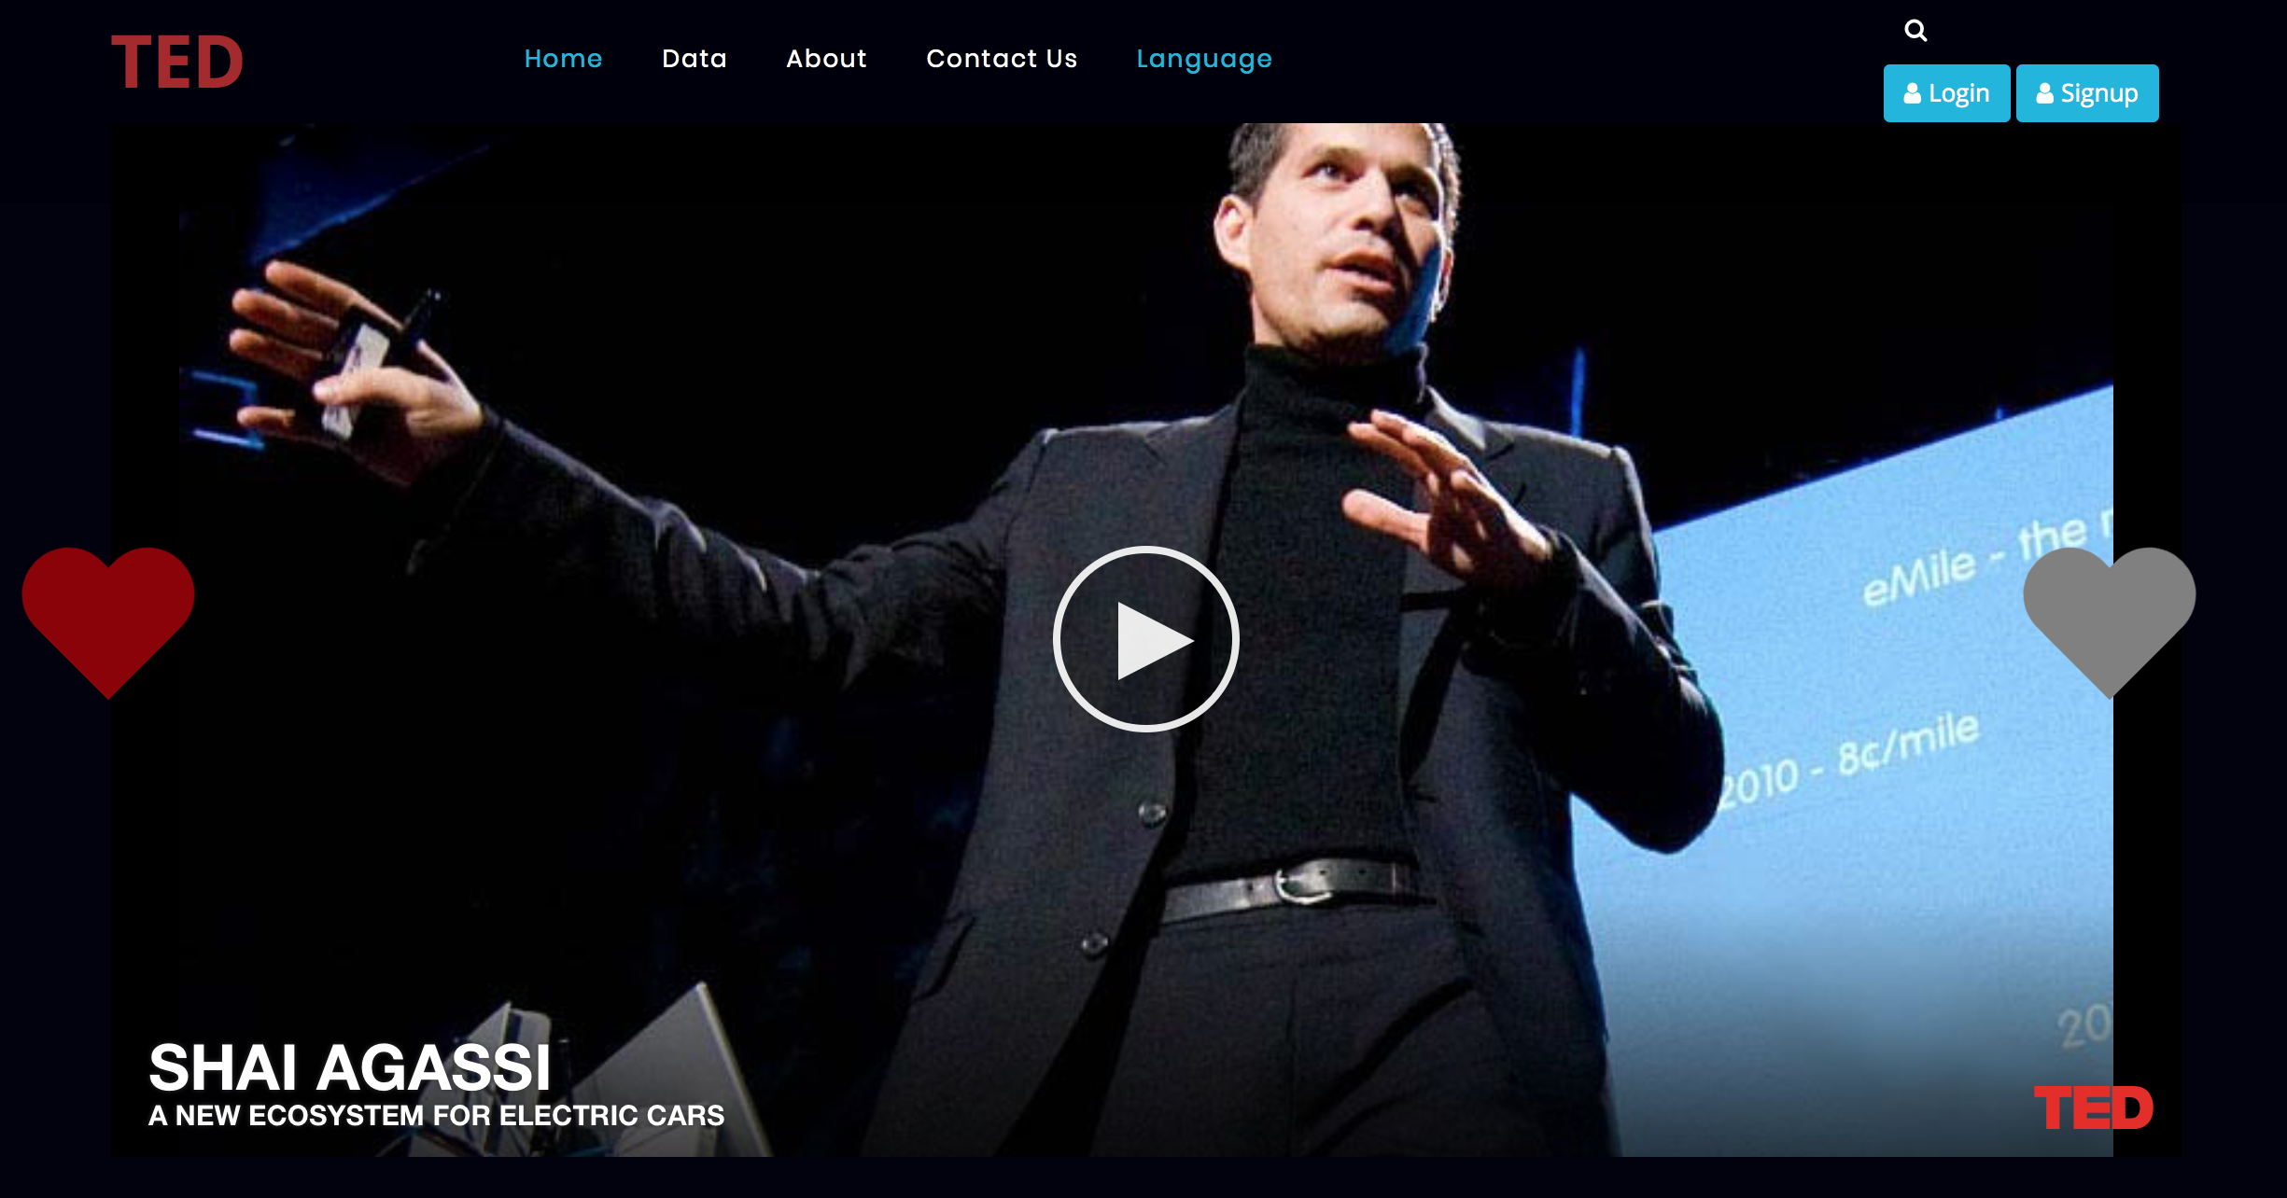
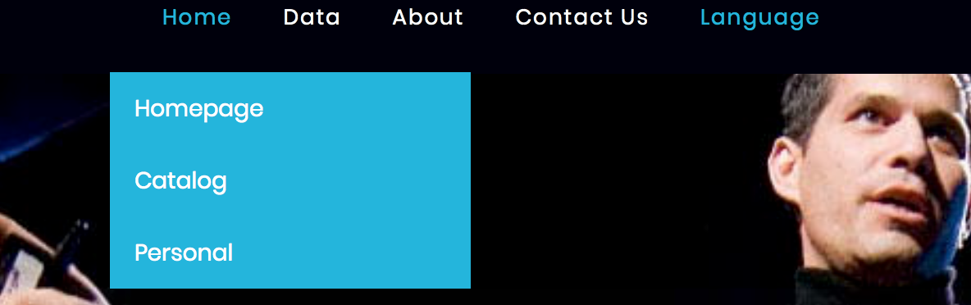
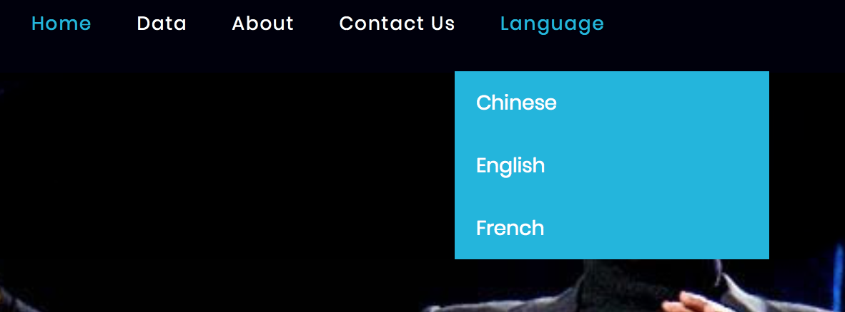
When we enter the website, the homepage will recommend some TED videos to us. We can choose to like or dislike according to our own preferences.
We can choose three languages.
We have implemented translation by using translater.js.
In addition, we can view the directory and use the personal homepage after registering and logging in.

Slide 24
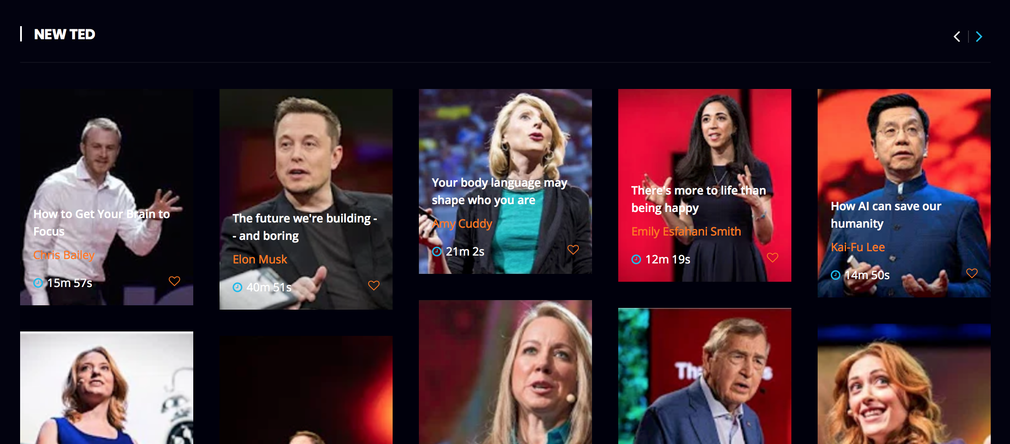
We will also push relevant videos to users based on the heat or upload time of TED.

Slide 25
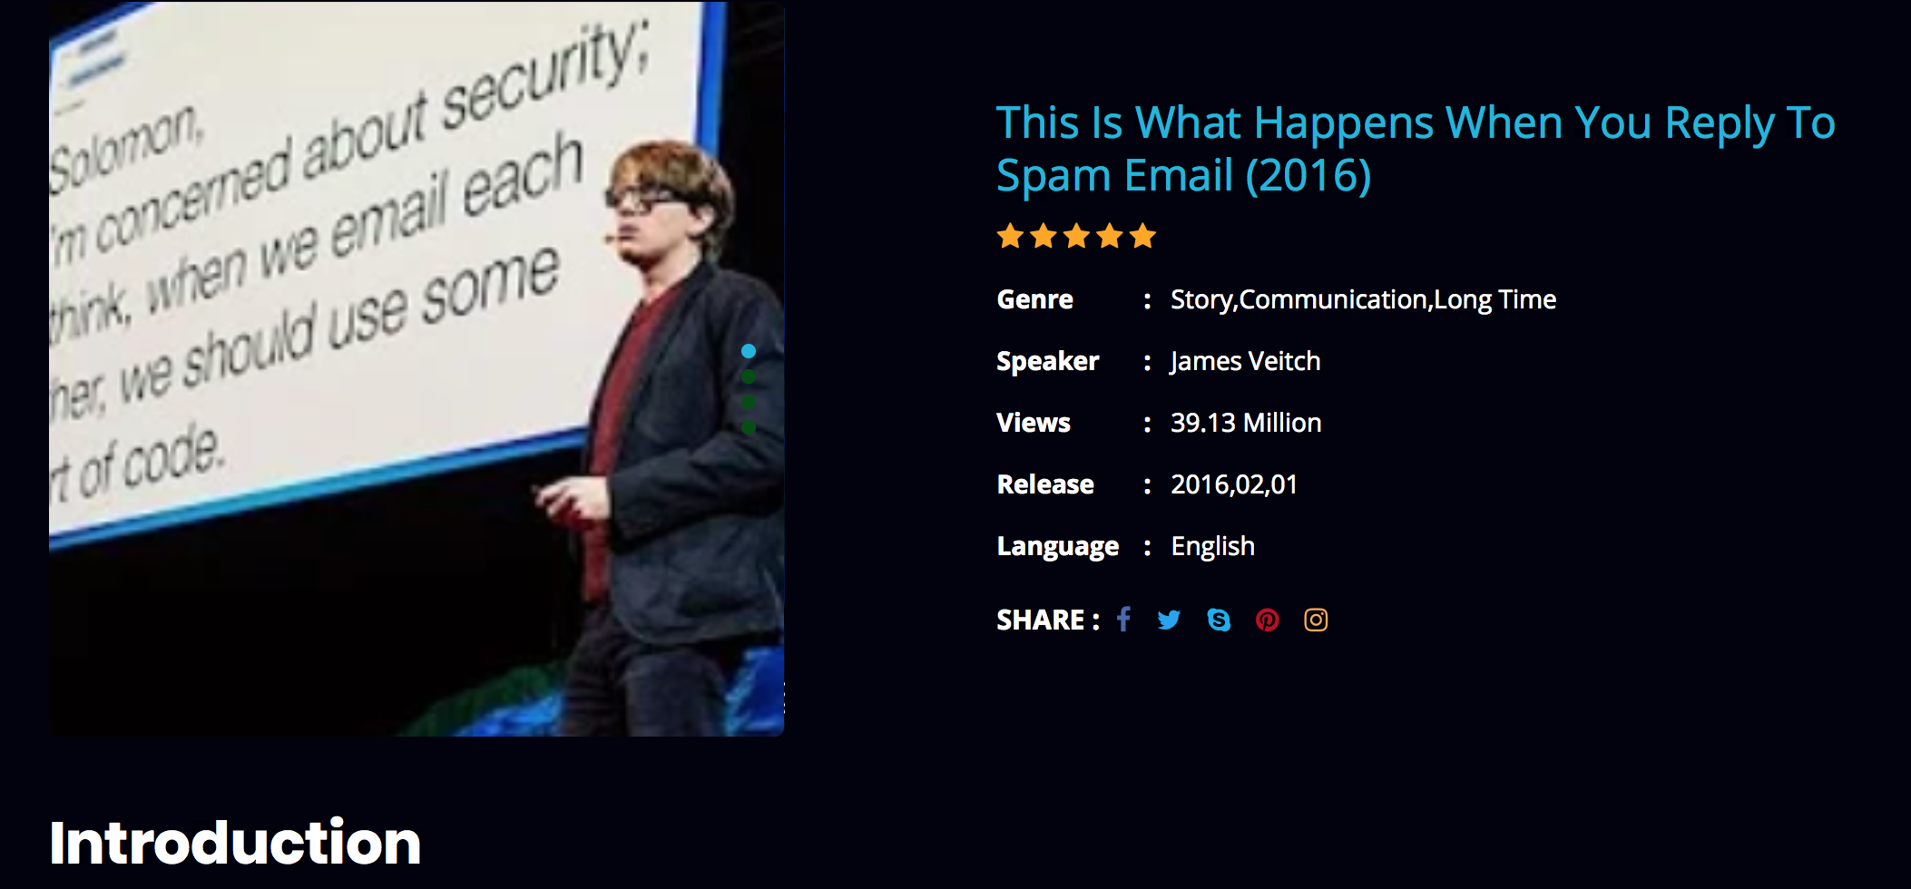
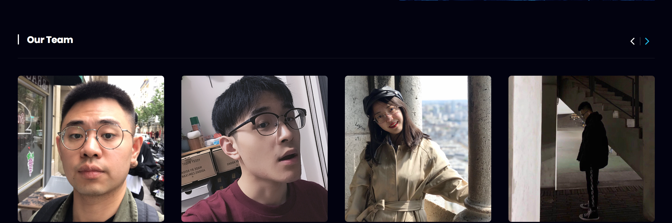
We will select the most played TED video on the data page and attach an introduction.
And we want to display the relevant data graph below the page according to the category of the dataset TED video, and display the forecast data graph.
We give us a brief introduction on the page of About Us.

Slide 26
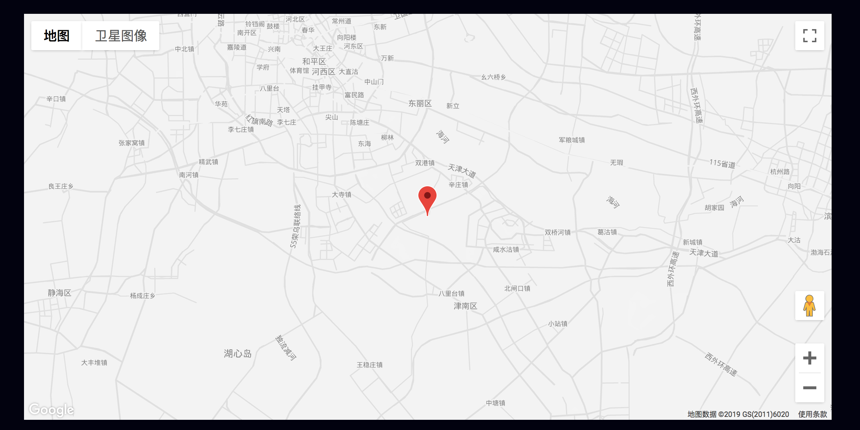
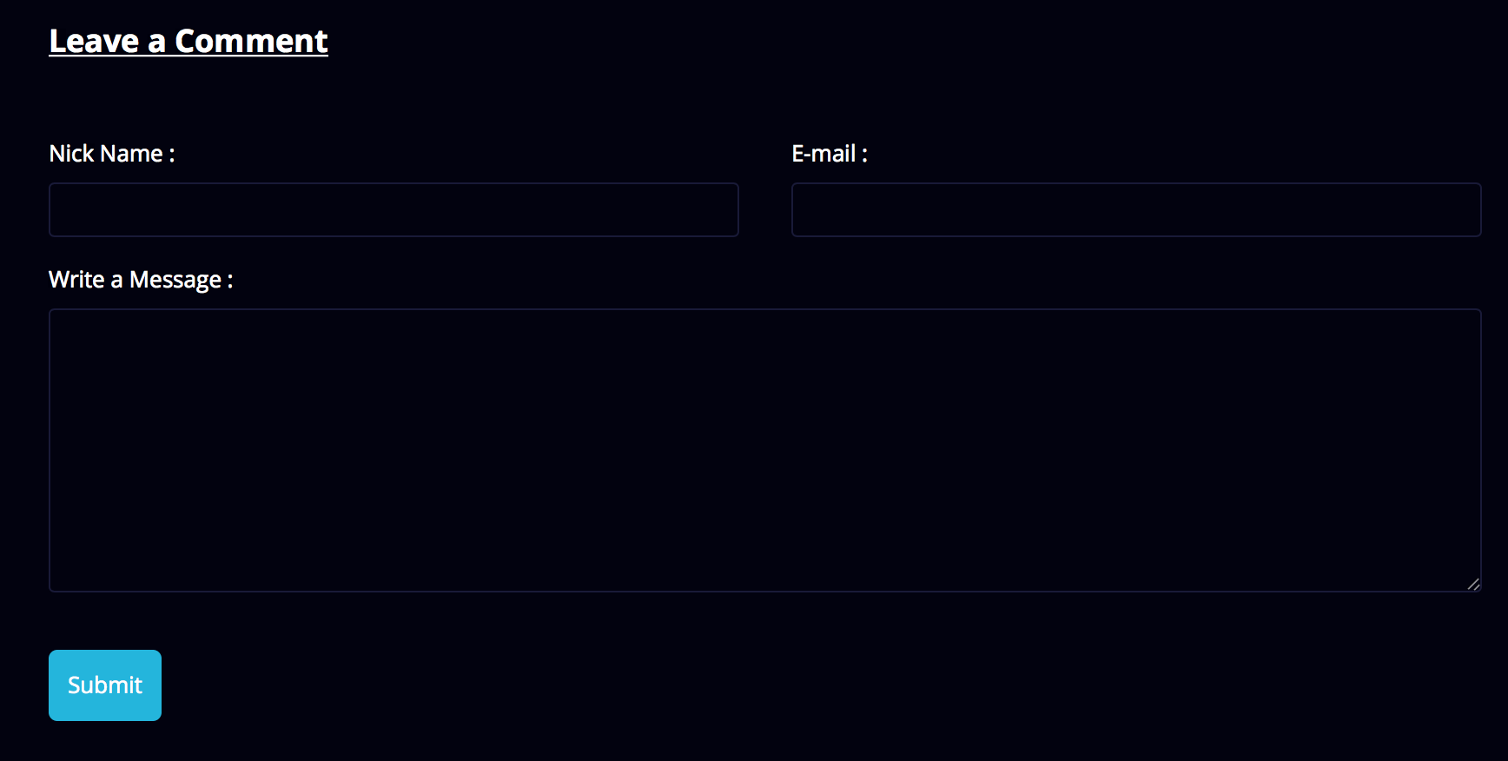
We use Google Maps to display the location of our school on the Contact Us page.
And this map is dynamic.
Users can leave us some messages, but they must follow the correct format.
Some features may not be perfect, and some sections need to be connected to the backend.

Slide 27
Thank you

